Slide 1
AJAX, PHP & MySQL
C273 – Advanced Web Application Development in PHP

Slide 2
Recap on AJAX
Asynchronous JavaScript and XML
Client-side technology for JavaScript to transfer data between browser and server in the background asynchronously
Provide better responsiveness, without locking down the browser

Slide 3
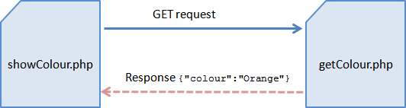
AJAX & JSON
Step 3: JSON message is sent back as response
Step 2: PHP Web Service processes the request
Step 1: Web page sends a HTTP GET request using AJAX

Slide 4
AJAX with jQuery
The $.ajax(settings) or $.ajax(url, settings)
Used for sending an Ajax request. The settings is an object of key-value pairs:
url: The request URL
type: GET or POST.
data: Request parameters (name=value pairs). Can be expressed as an object (e.g., {name:"peter", msg:"hello"}), or query string (e.g., "name=peter&msg=hello").
dataType: Expected response data type, such as text, xml, json, script or html.
headers: an object for request header key-value pairs.

Slide 5
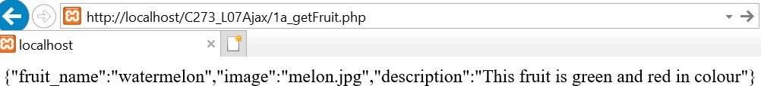
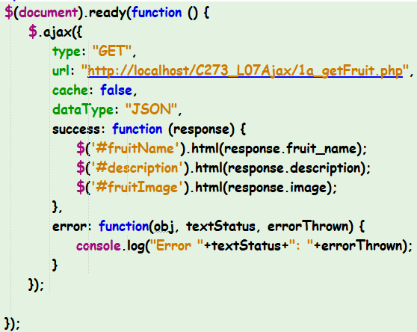

Recap L07 Exercise 4a
Step 1: AJAX initiates Http GET request and retrieves response as JSON message
Step 2: Retrieve data from object and display using jQuery selector

Slide 6
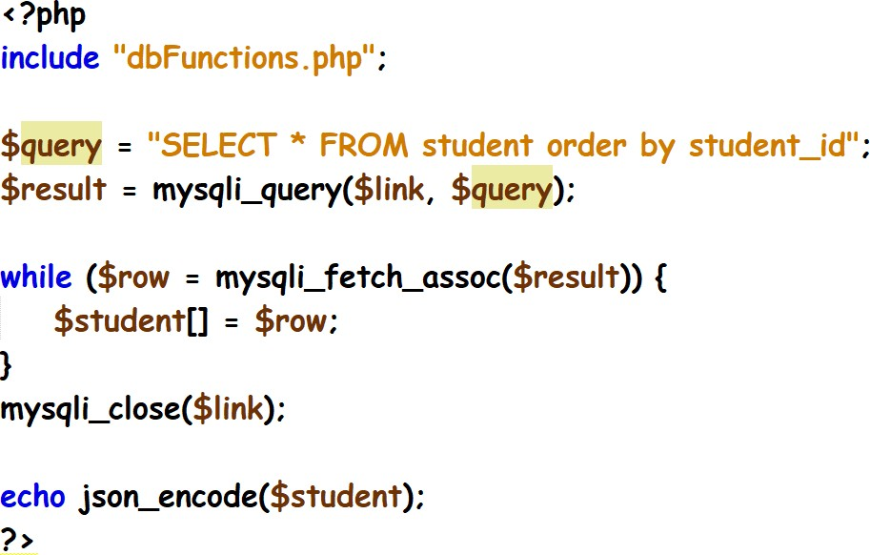
Recap PHP Webservice: getStudents.php
Retrieve all data from the database table student
Test it by executing the following: http://localhost/C273_L08Ajax/getStudents.php
You should get the following JSON response:

Slide 7
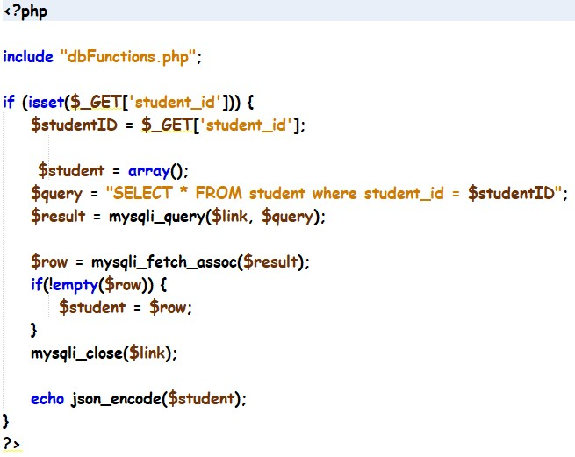
Recap PHP Webservice: getStudentDetails.php
Retrieve all data from the database table student based on the student id
Test it by executing the following: http://localhost/C273_L08Ajax/getStudentDetails.php?student_id=1111111 You should get the following JSON response:

Slide 8
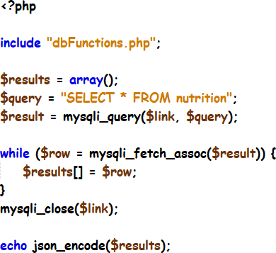
getNutrition.php solution

Slide 9
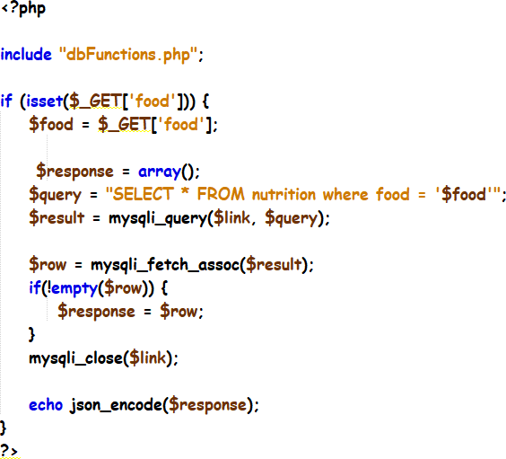
getNutritionByFood.php solution

Slide 10
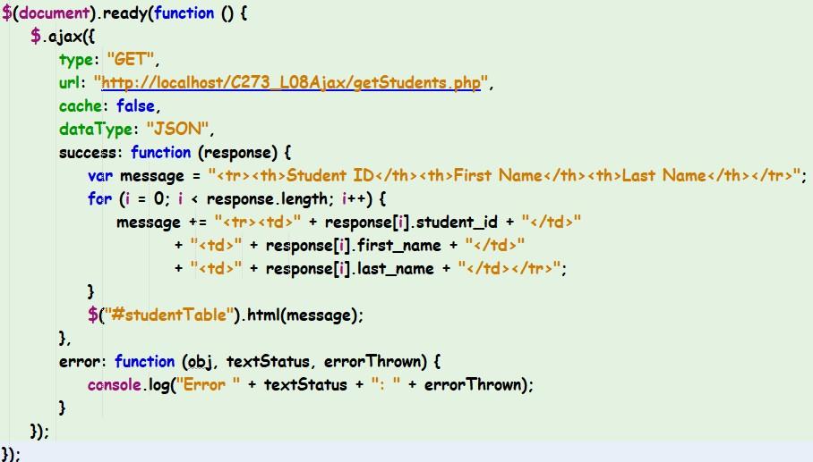
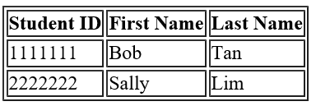
Exercise 1a
Step 1: AJAX initiates Http GET request and retrieves response as JSON message
Step 2: Retrieve multiple
records from object and display using jQuery selector

Slide 11
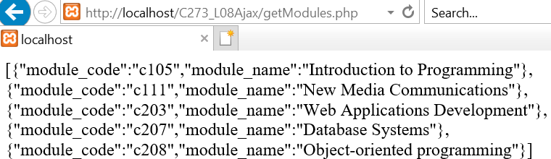
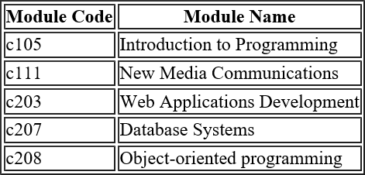
Exercise 1b
Display JSON response into a table

Slide 12
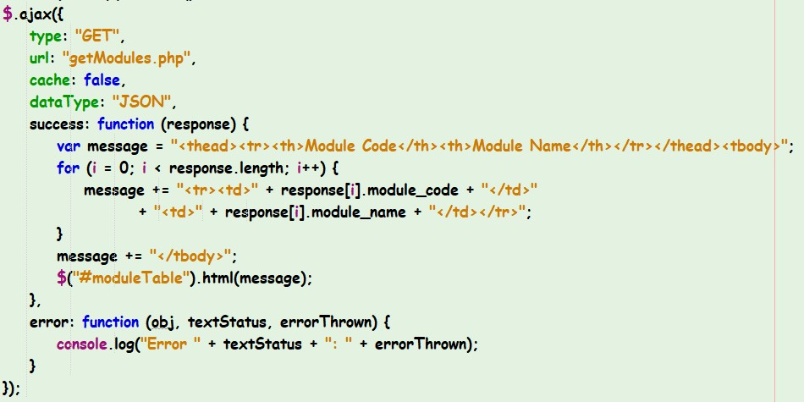
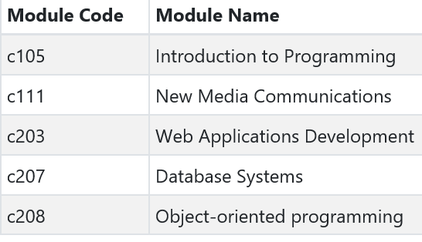
Exercise 1b Solution

Slide 13
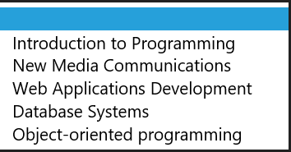
Exercise 1c
Display JSON response into a dropdown list

Slide 14
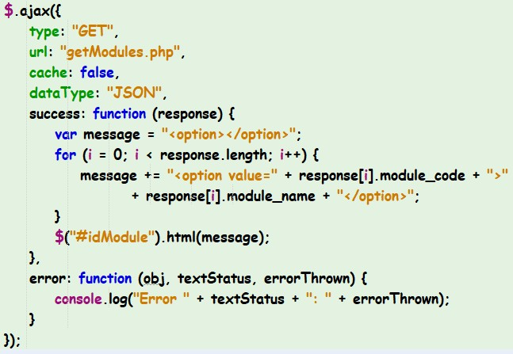
Exercise 1c Solution

Slide 15
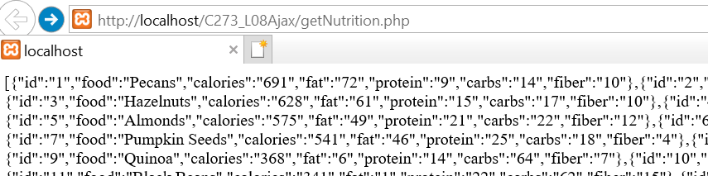
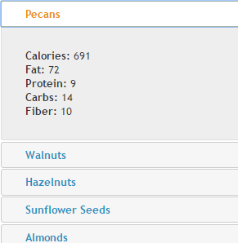
Exercise 1d
Display JSON response into a jQuery UI
Accordion widget

Slide 16
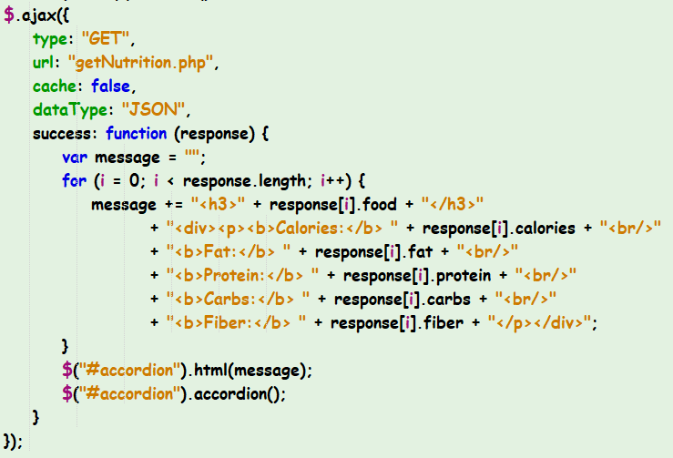
Exercise 1d Solution
Initialize accordion plugin

Slide 17

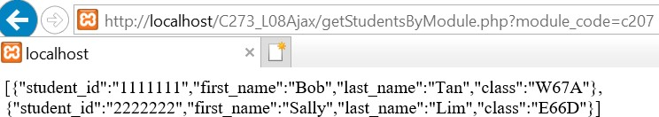
Exercise 2a
Make AJAX call upon clicking the Search button
Display JSON
response in table

Slide 18
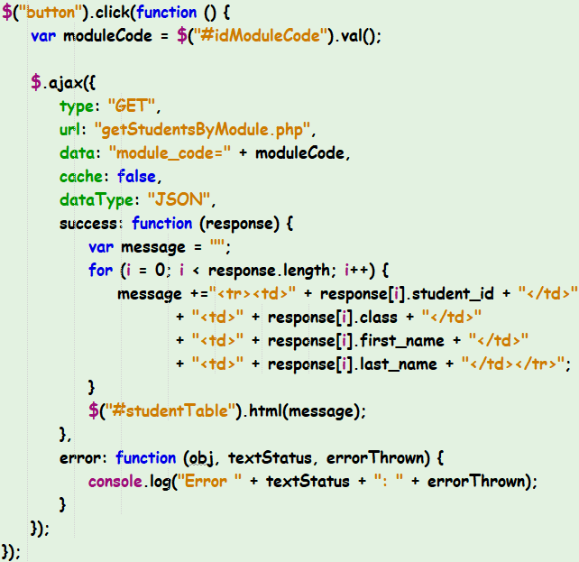
Exercise 2a solution

Slide 19
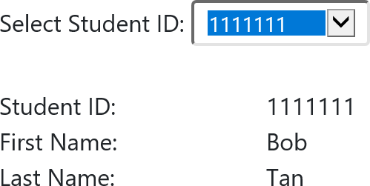
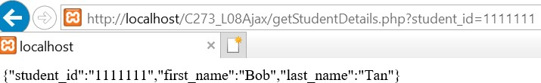
Exercise 2b
Make AJAX call upon selecting option in dropdown list
Display JSON
response in divs

Slide 20
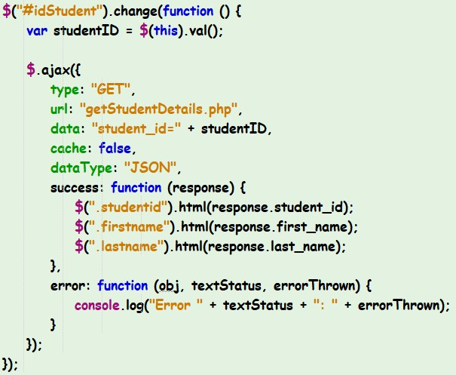
Exercise 2b solution

Slide 21
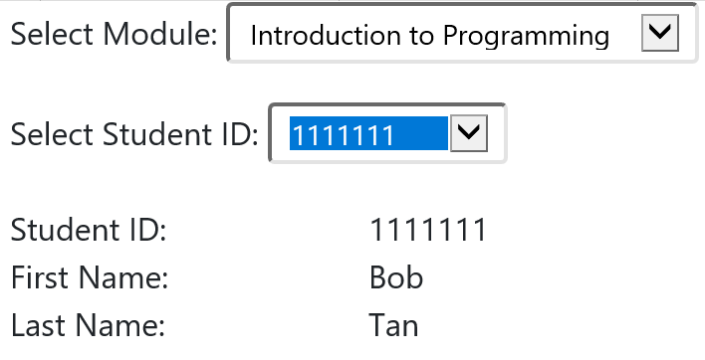
Exercise 2c
Step 1: Make AJAX call upon selecting option in dropdown list
Step 2: Display JSON response in dropdown list
Step 3: Make AJAX call upon selecting option in dropdown list
Step 4: Display JSON
response in divs

Slide 22
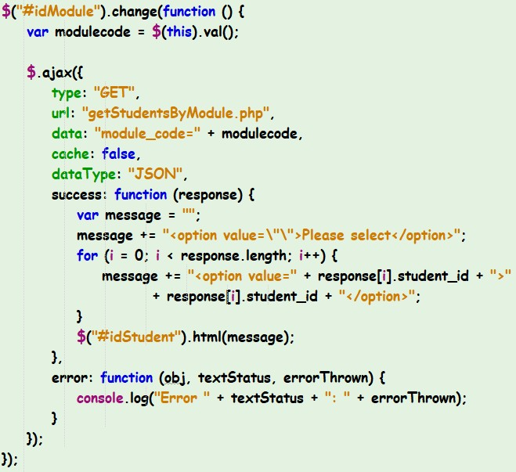

Exercise 2c solution

Slide 23
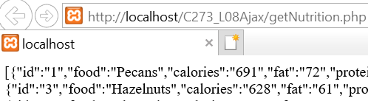
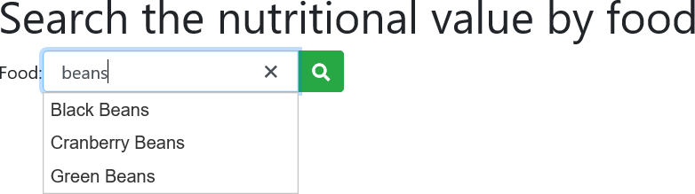
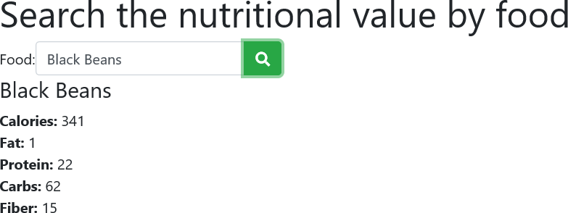
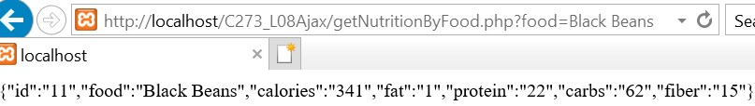
Exercise 2d
Step 1: Make AJAX call and load the JSON response in Autocomplete widget
Step 2: the Sear
Step 3: Load the JSON response in divs
Make AJAX call upon clicking ch button

Slide 24
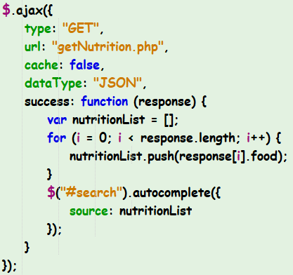
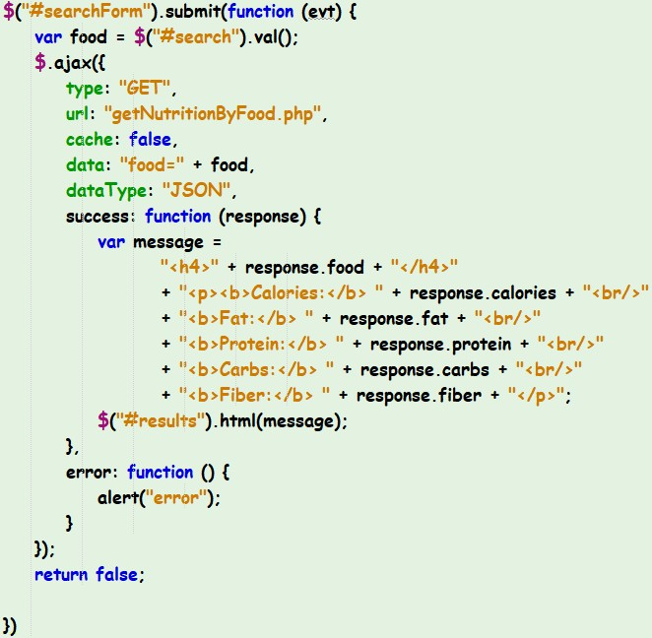
Exercise 2d solution

Slide 25
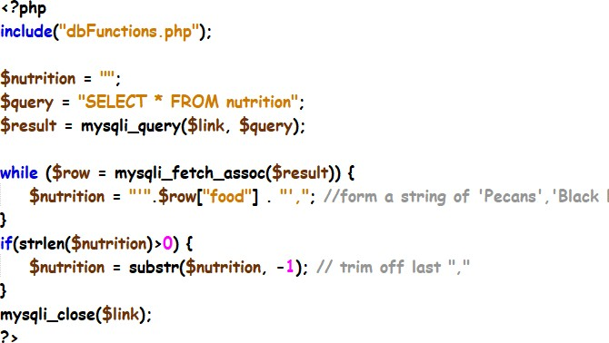


jQuery or PHP?
AJAX jQuery to fill JavaScript array
PHP to fill JavaScript array

Slide 26
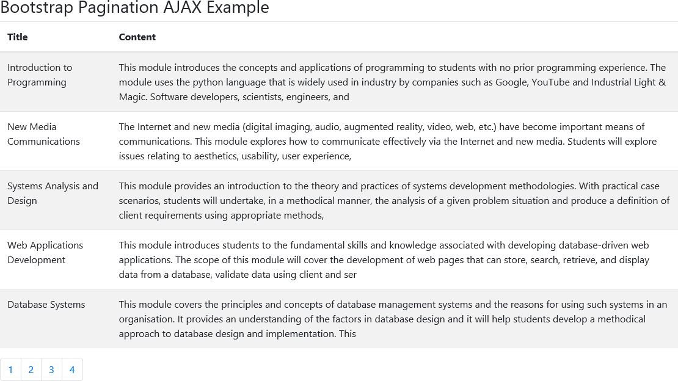
Exercise 3a
Make AJAX call and load 5 records at a time in Bootstrap table
Create Pagination component

Slide 27

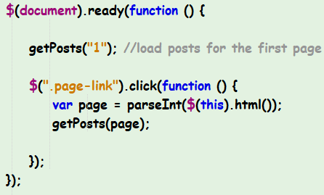
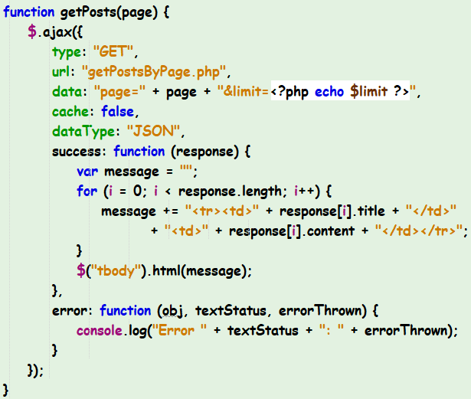
Exercise 3a solution
Create a function that passes the page number as an argument.

Slide 28
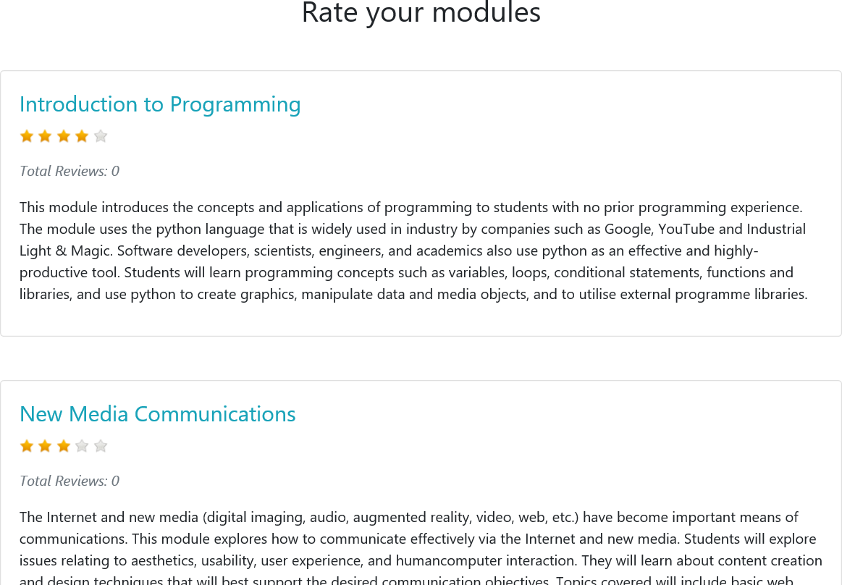
Exercise 3b
Update/Insert ratings table when the user clicks on the star ratings

Slide 29
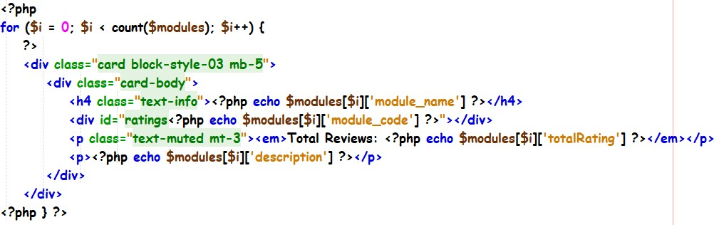
Exercise 3b solution
HTML Code
In order to use multiple sets of star ratings in a web page, you need to initialize a unique raty plugin for every set.
$(“ratingsc105”).raty({…});
$(“ratingsc111”).raty({…});
$(“ratingsc203”).raty({…});

Slide 30
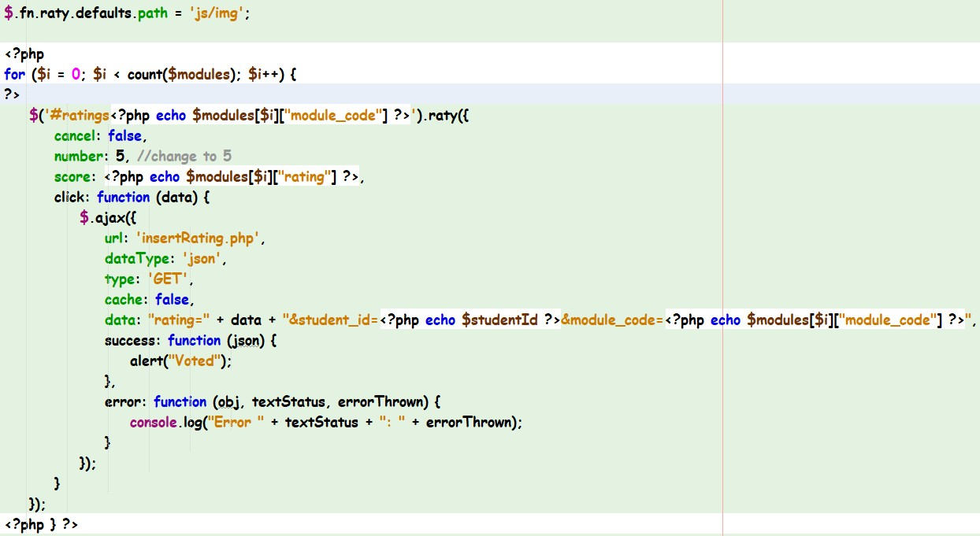
Exercise 3b solution
Set initial rating from database
Callback executed on rating click

Slide 31
What you learnt today
Consume PHP Web service using JQuery.ajax()
Perform form submission using AJAX and JQuery
Retrieve JSON message and perform page update by manipulating DOM using JQuery selectors.

